Slide 1

Overview
Notes:
textbox
No alt text provided
textbox
No alt text provided
slicer
No alt text provided
slicer
No alt text provided
Month
No alt text provided
sda
No alt text provided
sda
No alt text provided
sda
No alt text provided
Revenue By Sub Category
No alt text provided
Revenue By Category
No alt text provided
Revenue By Product
No alt text provided
pivotTable
No alt text provided
Revenue By Category
No alt text provided

Slide 2
Overview
OBJECTIVE OF ANALYSIS
Perform Analysis on Amazon dataset to predict the metrics that will be used to maximize the results while running ads during Diwali sale.
Tech And Skills Used :
Python , Excel , Google Collab , Canva ,PowerPoint
Notes:
textbox
No alt text provided
textbox
No alt text provided
slicer
No alt text provided
slicer
No alt text provided
Month
No alt text provided
sda
No alt text provided
sda
No alt text provided
sda
No alt text provided
Revenue By Sub Category
No alt text provided
Revenue By Category
No alt text provided
Revenue By Product
No alt text provided
pivotTable
No alt text provided
Revenue By Category
No alt text provided

Slide 3
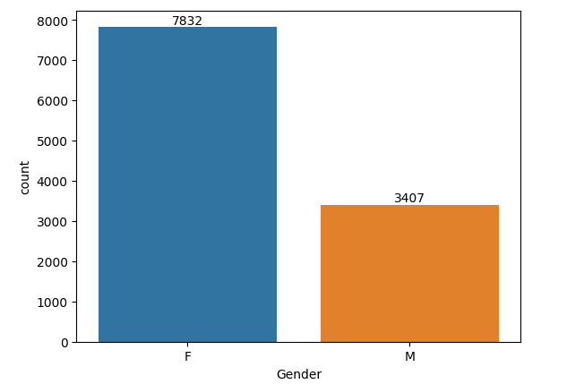
Purchase Count As Per Gender
Findings : Females have more purchasing power compared to men.

Slide 4
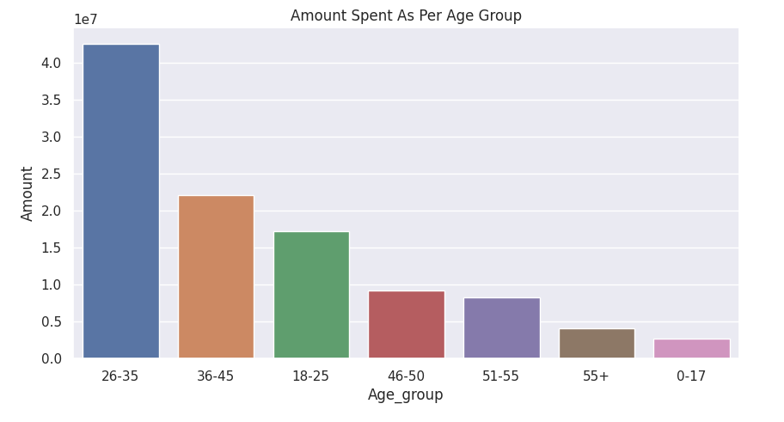
Purchase Count As Per Age Group
Findings : Age group 26 – 35 and 18 – 25 have more purchasing potential .

Slide 5
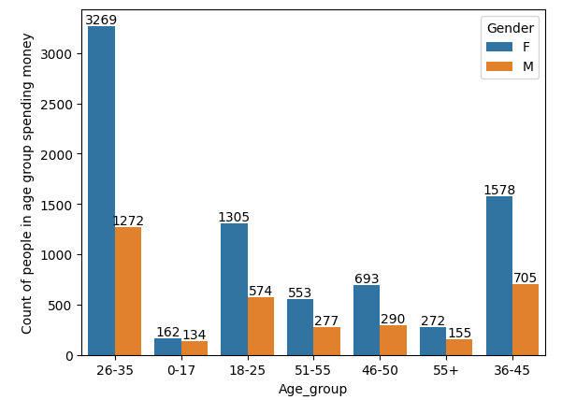
Purchase Count As Per Gender And Age Group
Findings : Females in age group 26 – 35 have more purchasing potential .

Slide 6
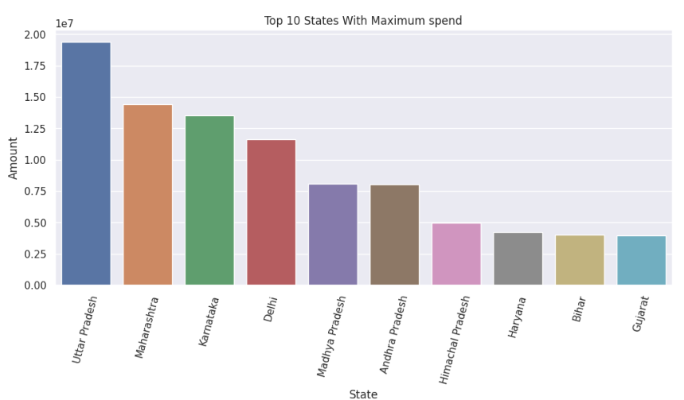
Top 10 States Spending Maximum Money
Findings : Uttar Pradesh and Maharashtra spend maximum money .

Slide 7
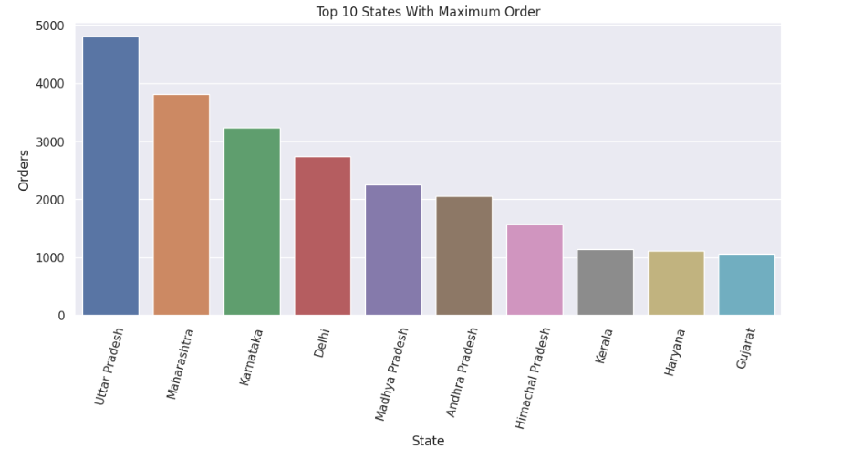
Top 10 States Buying Maximum Quantity
Findings : Uttar Pradesh and Maharashtra buy maximum product .

Slide 8
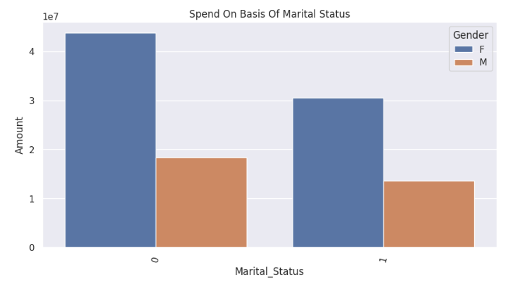
Purchase Power As Per Marritial Status
Findings : Married people spend more money , females spend
max in both category .

Slide 9
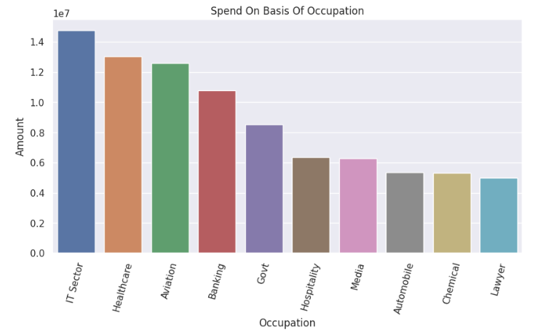
Spend As Per Occupation
Findings : People working in IT , Healthcare and Aviation spend maximum .

Slide 10
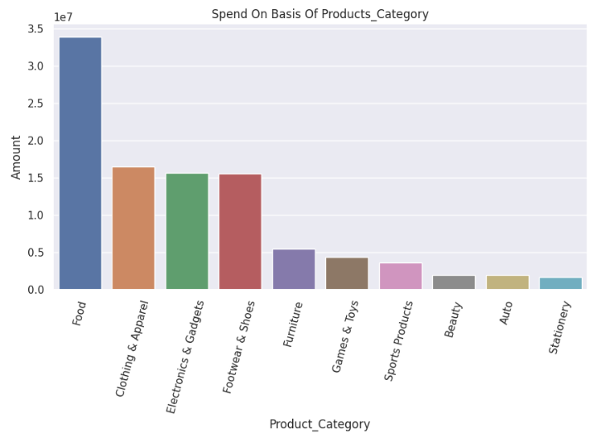
Spend As Per Product Category
Findings : People spend maximum money on Food , Clothes and Electronics.

Slide 11
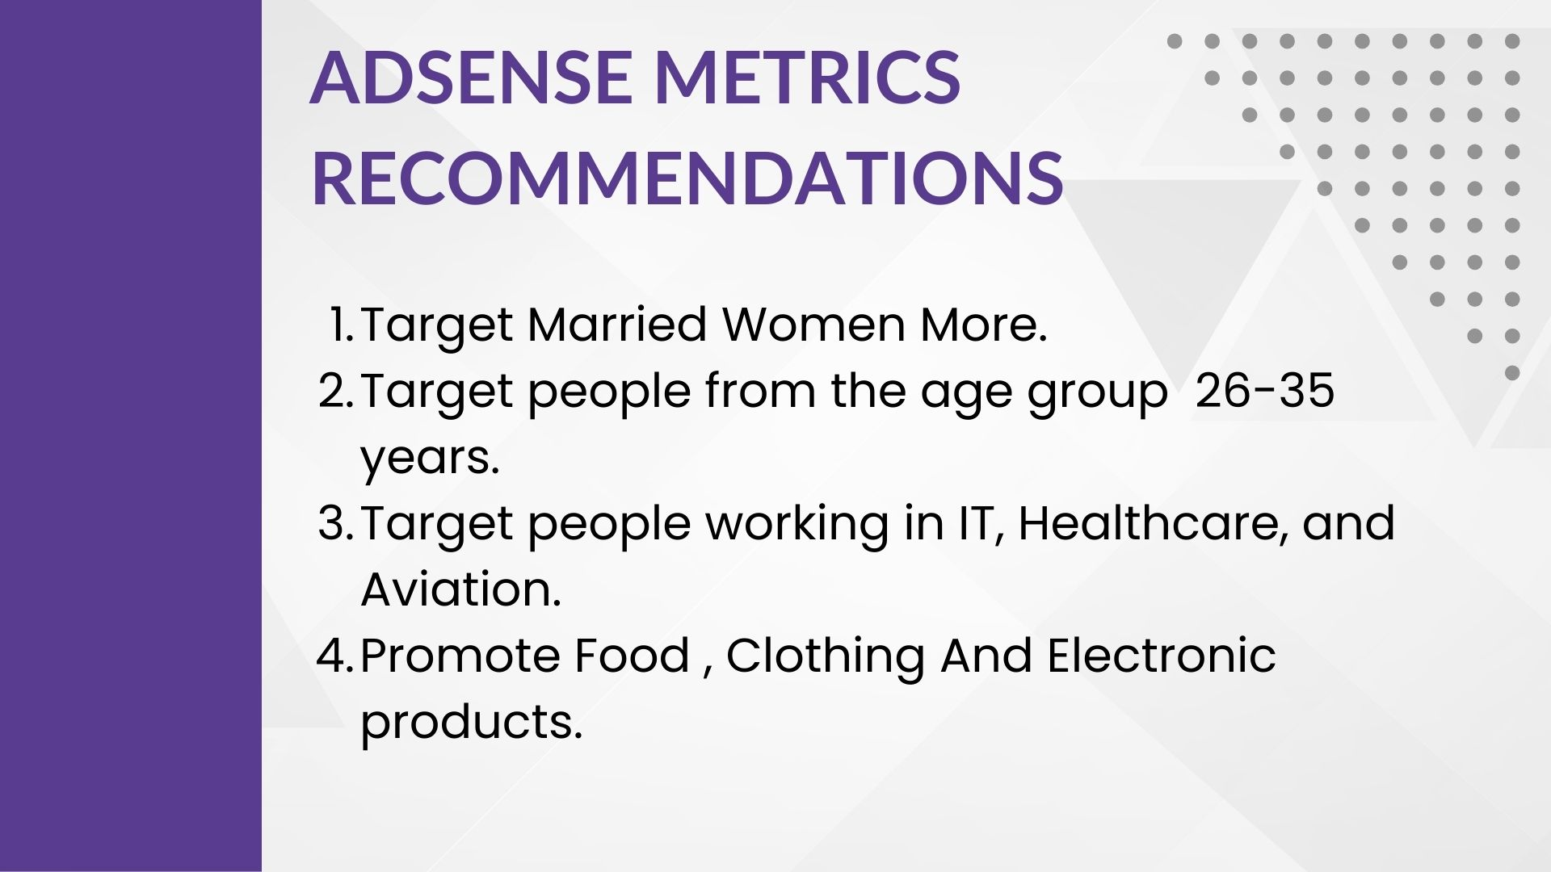
Employee Based Analysis
Notes:
textbox
No alt text provided
textbox
No alt text provided
slicer
No alt text provided
slicer
No alt text provided
Month
No alt text provided
sda
No alt text provided
sda
No alt text provided
sda
No alt text provided
Revenue By Employee
No alt text provided
pivotTable
No alt text provided
Revenue By Category
No alt text provided
Units Sold By Employee
No alt text provided

